Slide 1
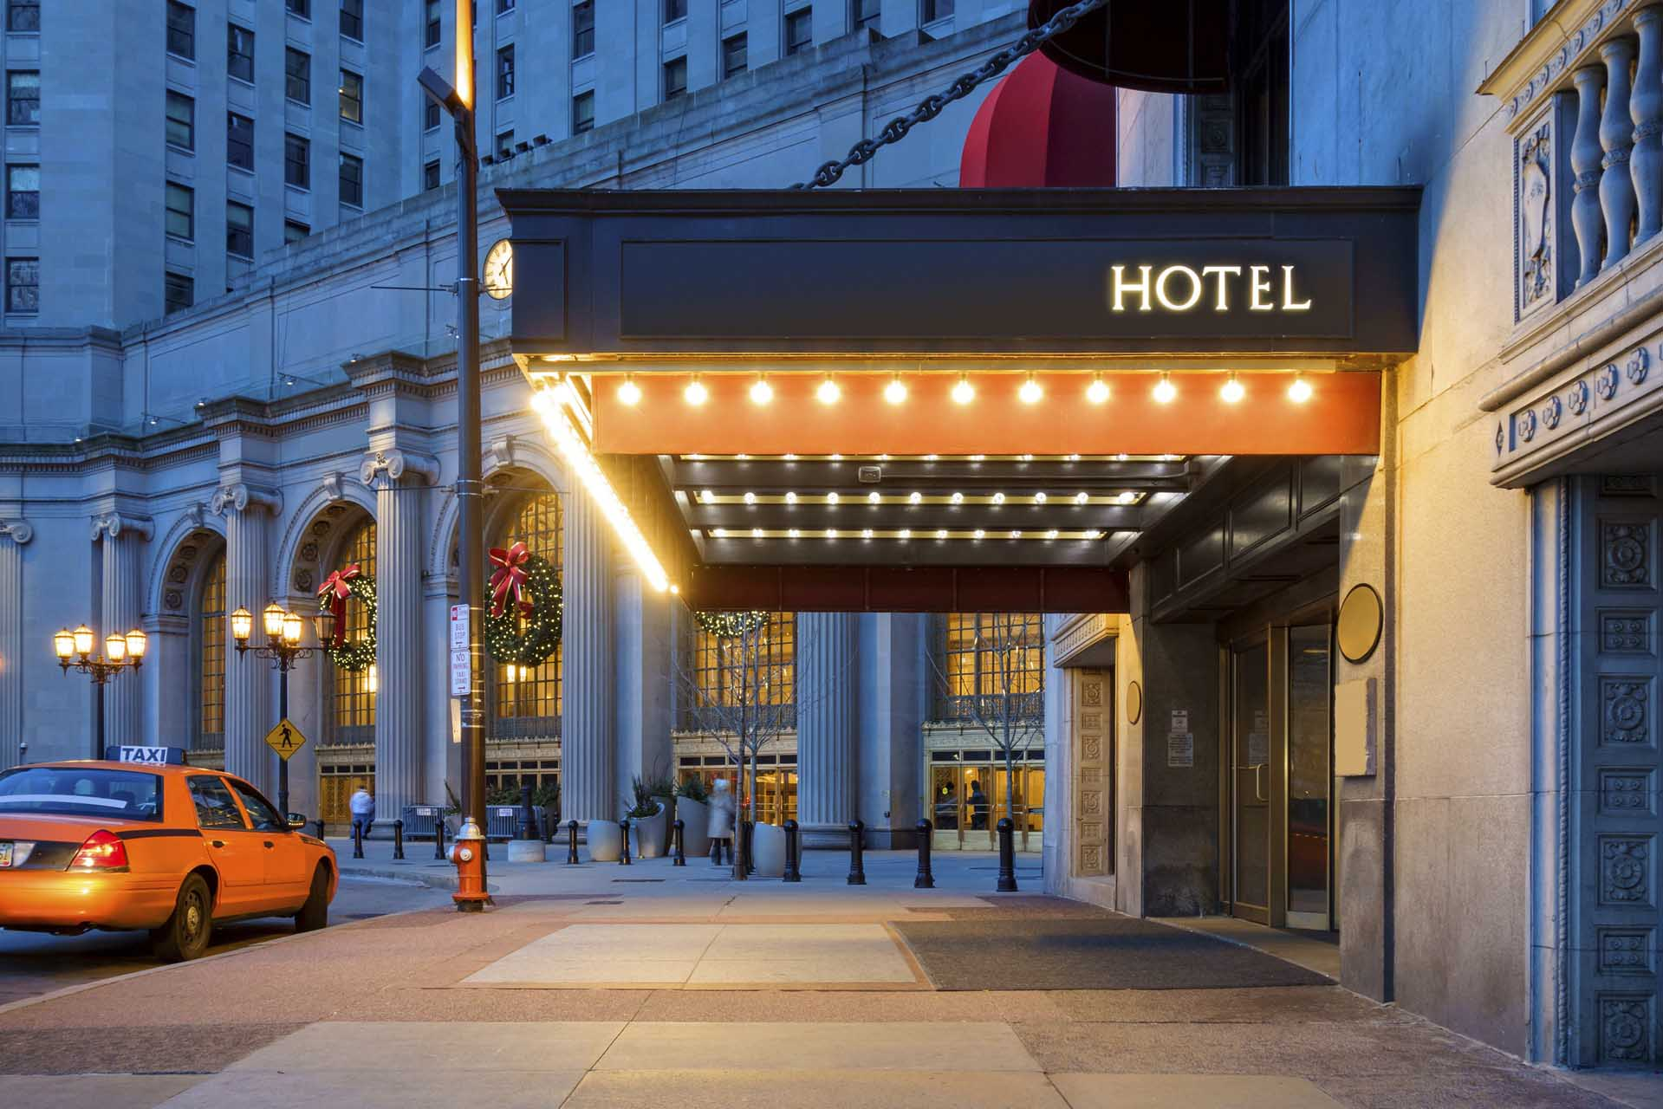
Hotel Management System
HARI HARAN VADAKATTU
SHUBHAM BHARGAVA
KIRTHANA RAJAGOPAL CHIRAMDASU
NEHA DONGRE

Slide 2
Abstract
This project’s objective is to help the customer with their hotel reservations and helping the hotel with their regular tasks, which includes maintaining a database that stores customer information and services provided from all the different branches.
To survive in a competitive market, a hotel must have at least two things:
Have an online presence that facilitates
the reservation process for visitors.
Provide exceptional customer service to help the
customers with their queries/issues.

Slide 3
Objectives
The main objective is to create a centralized system for a chain of hotels.
Centralized System contains all the rates of each hotel room depending on whether it is peak season/offseason.
Customer must pay the bill during check-out for all the services used.
Customer can make reservations and pay before check-in. Cancellation charges will be applied if not canceled before check-in time.
A single customer can have multiple reservations in a single booking. customers can check out whenever they want to, but extending their stay is subject to availability.
Customers can update their reservations before checkin.

Slide 4
Layout
01
Design Documents
02
E-R Diagram
03
Database Objects
04
Presentation
Briefs the entities
Showcases the relations of the database
DDLs, stored procedures, Views, Trigger.
Dashboards & Reports

Slide 5
Design Document
The database has 11 different entities with many other attributes that help us understand what data hotel stores to smoothen the day-to-day activities.
The detailed explanation is given in the link

Slide 6
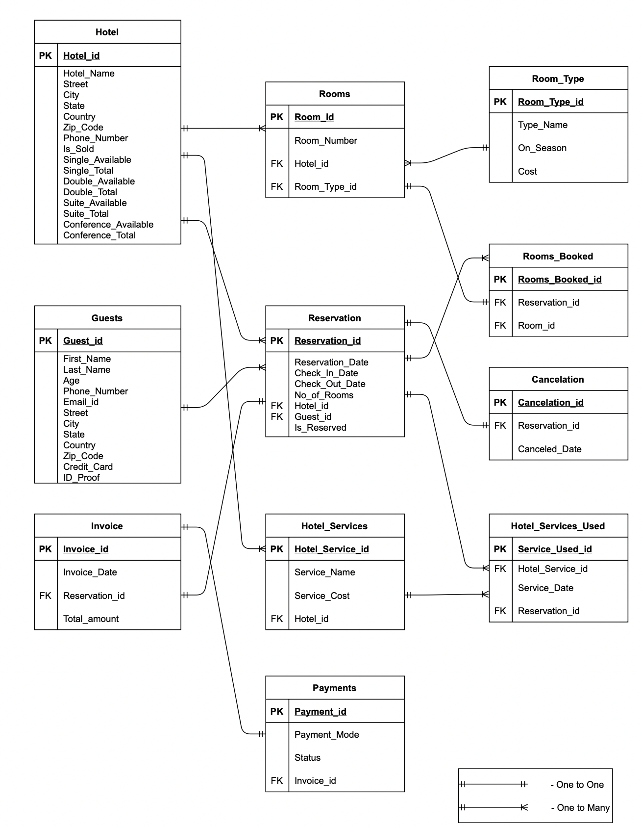
E-R Diagram.

Slide 7
DDL STATEMENTS
We have created the database named project and created different tables like Hotel, Guest, Room_Type, Rooms, Hotel Services, Reservation (which has a computed column based on a function which calculates number of days stayed using the check in and checkout dates), Cancelation, Rooms_Booked, Hotel_Services_Used, Invoice, Payments. These tables has many different attributes as per hotel’s requirement.
Link

Slide 8
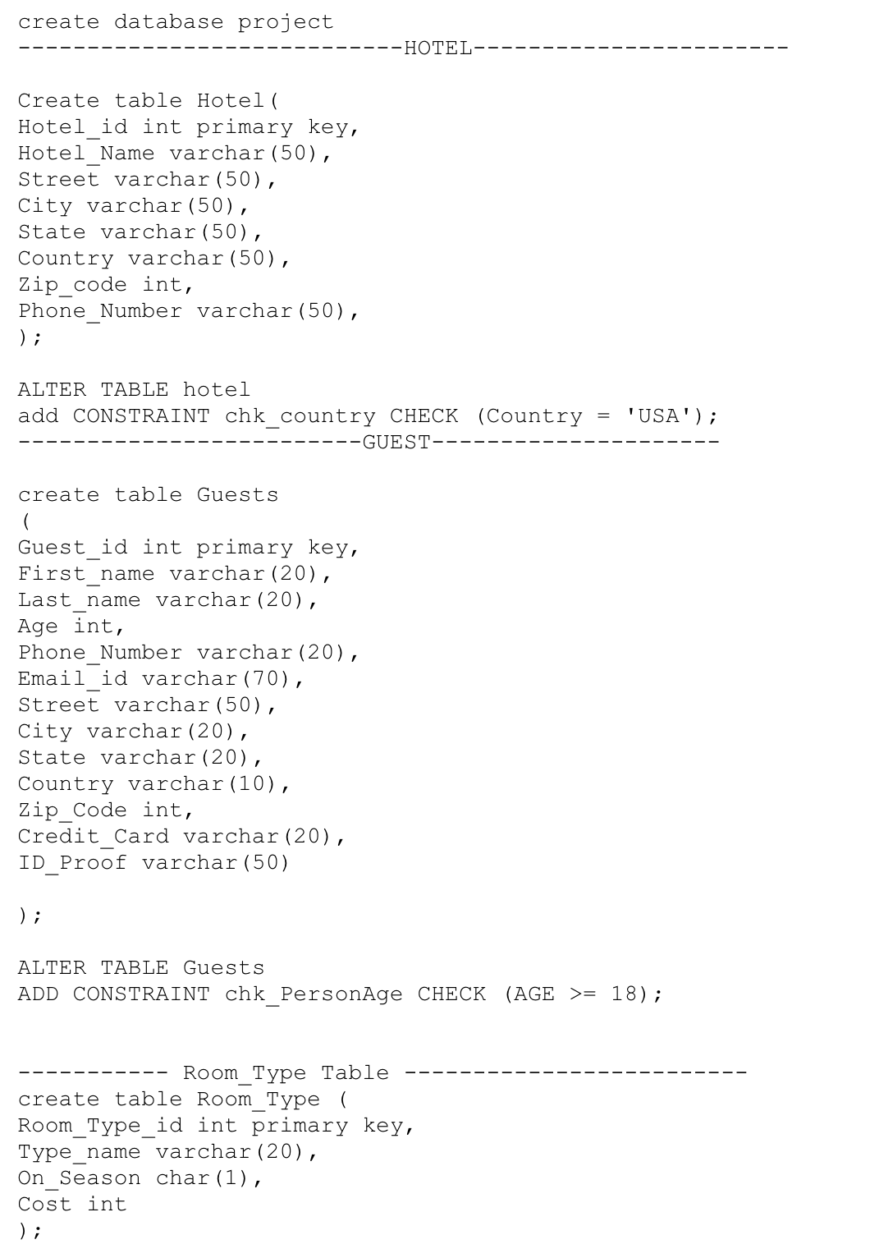
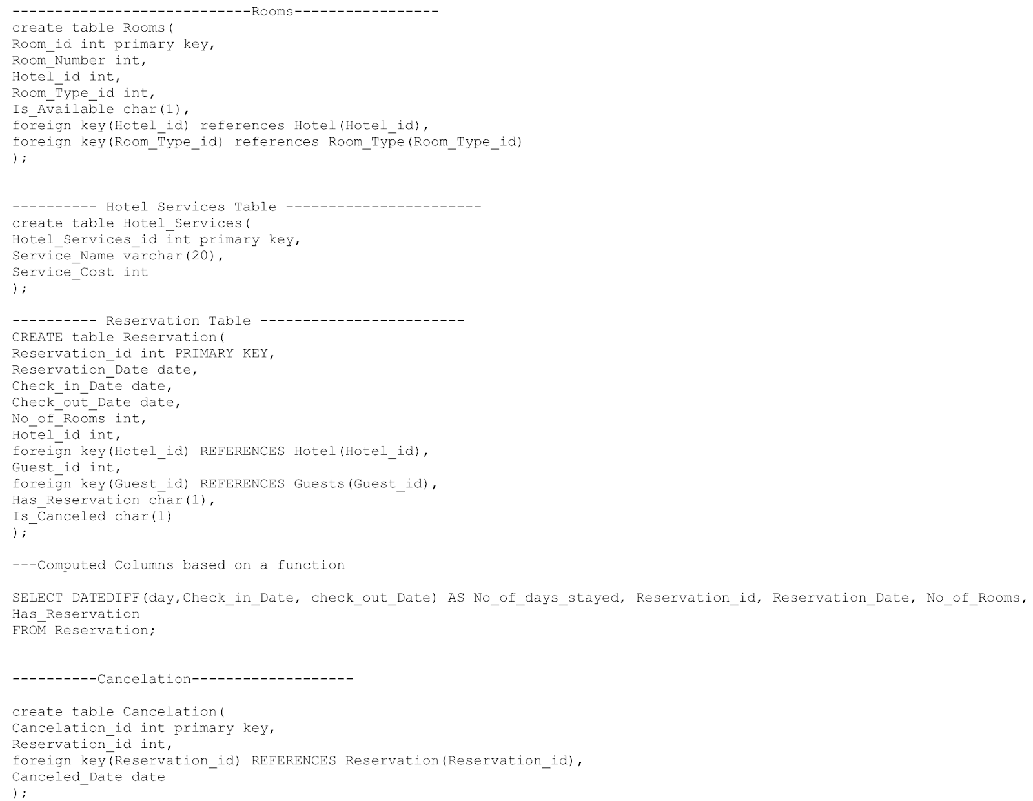
DDLs

Slide 9
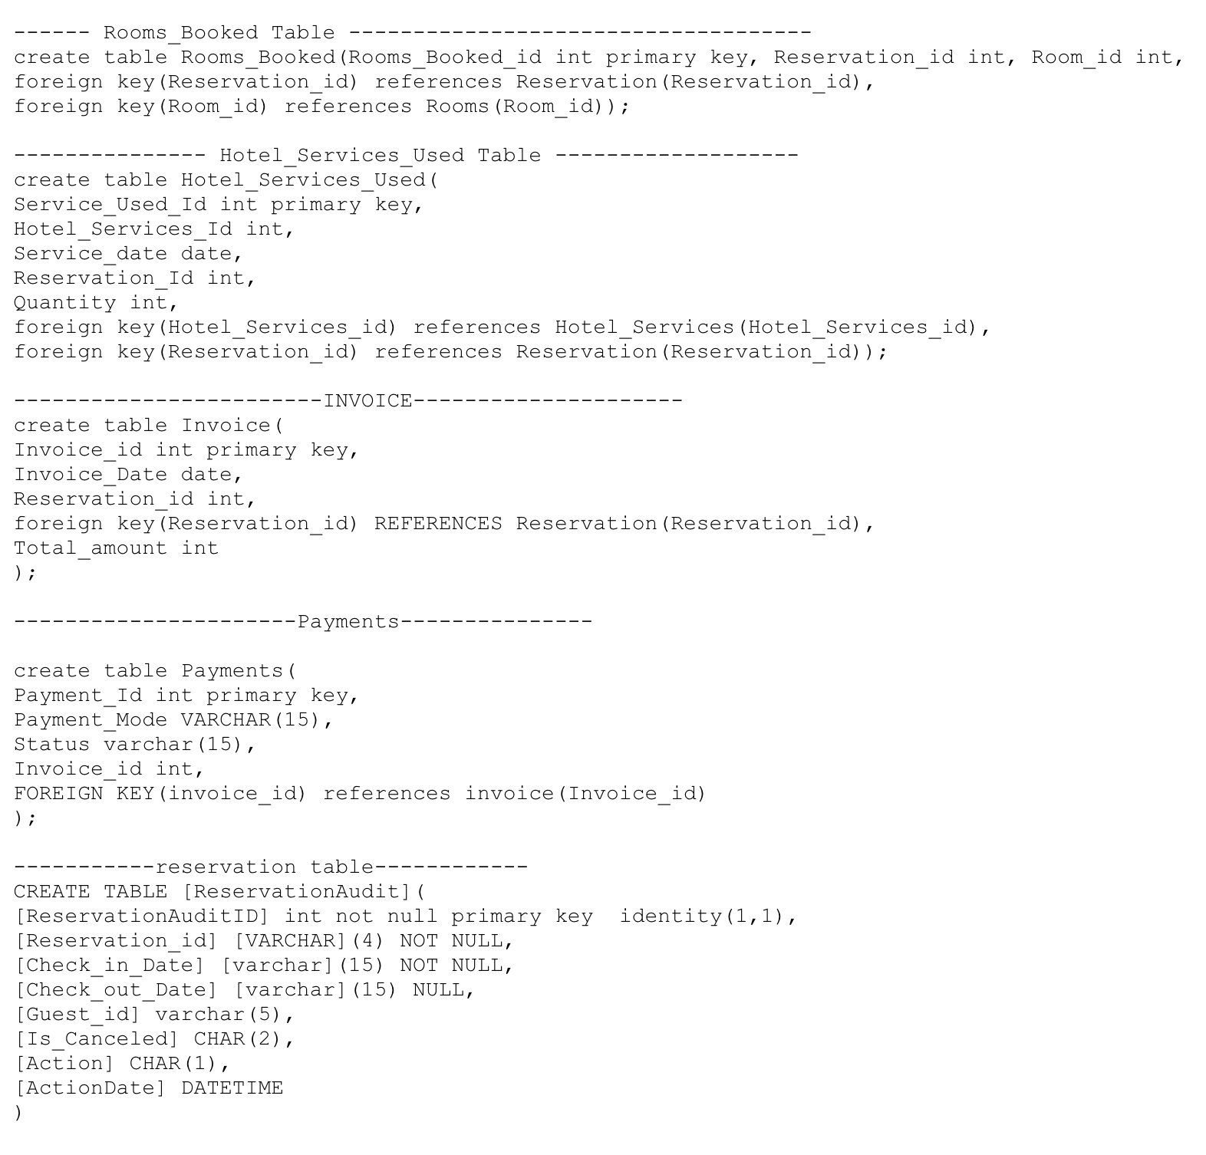
DDLs

Slide 10
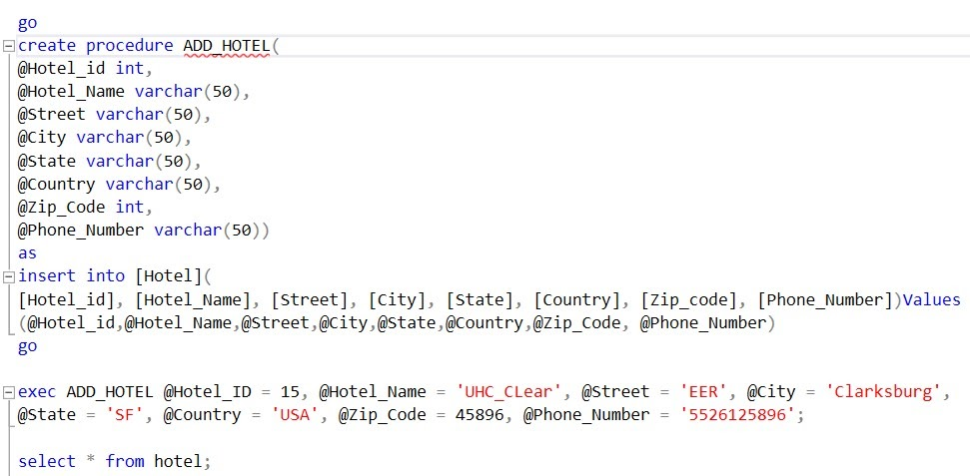
STORED PROCEDURE - 1
Link
This stored procedure is used when the new hotel is to be added into the database

Slide 11
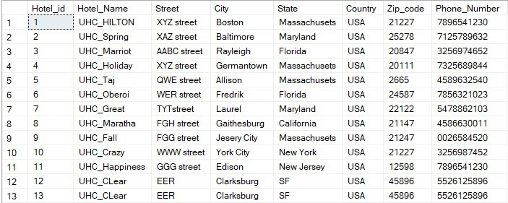
Output of the stored procedure -1

Slide 12
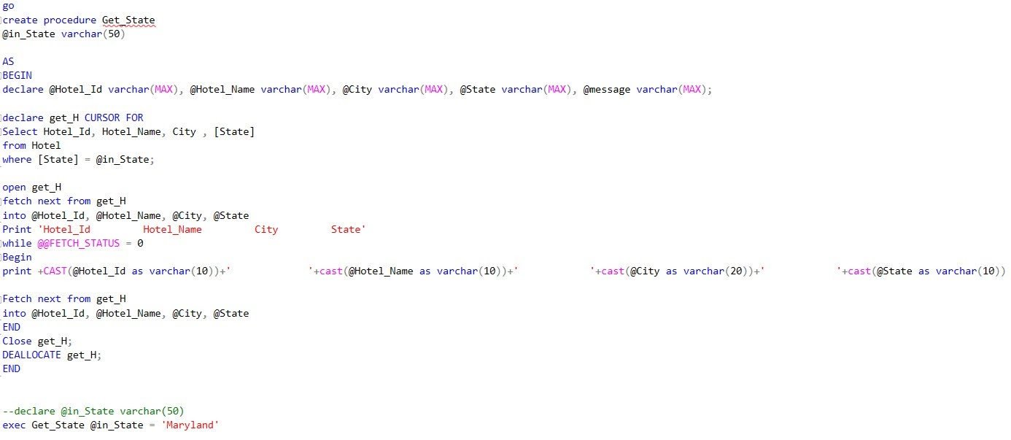
STORED PROCEDURE -2
This Stored procedure is used when we need to know the hotels present in the given location.

Slide 13
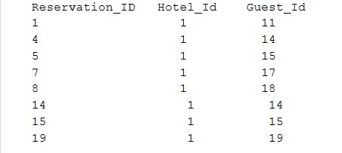
Output of the stored procedure -2

Slide 14
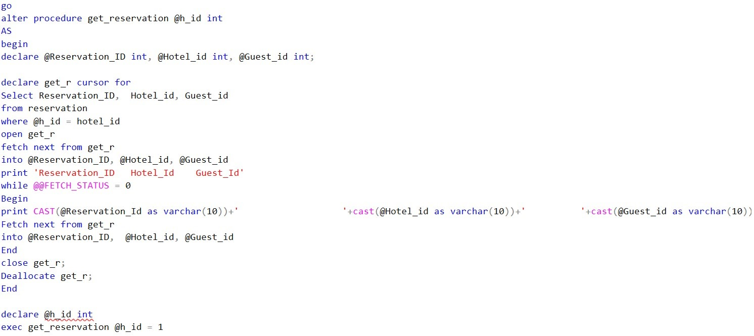
STORED PROCEDURE -3
It displays the reservations made in the hotel along with guest_id

Slide 15
Output of stored procedure -3

Slide 16
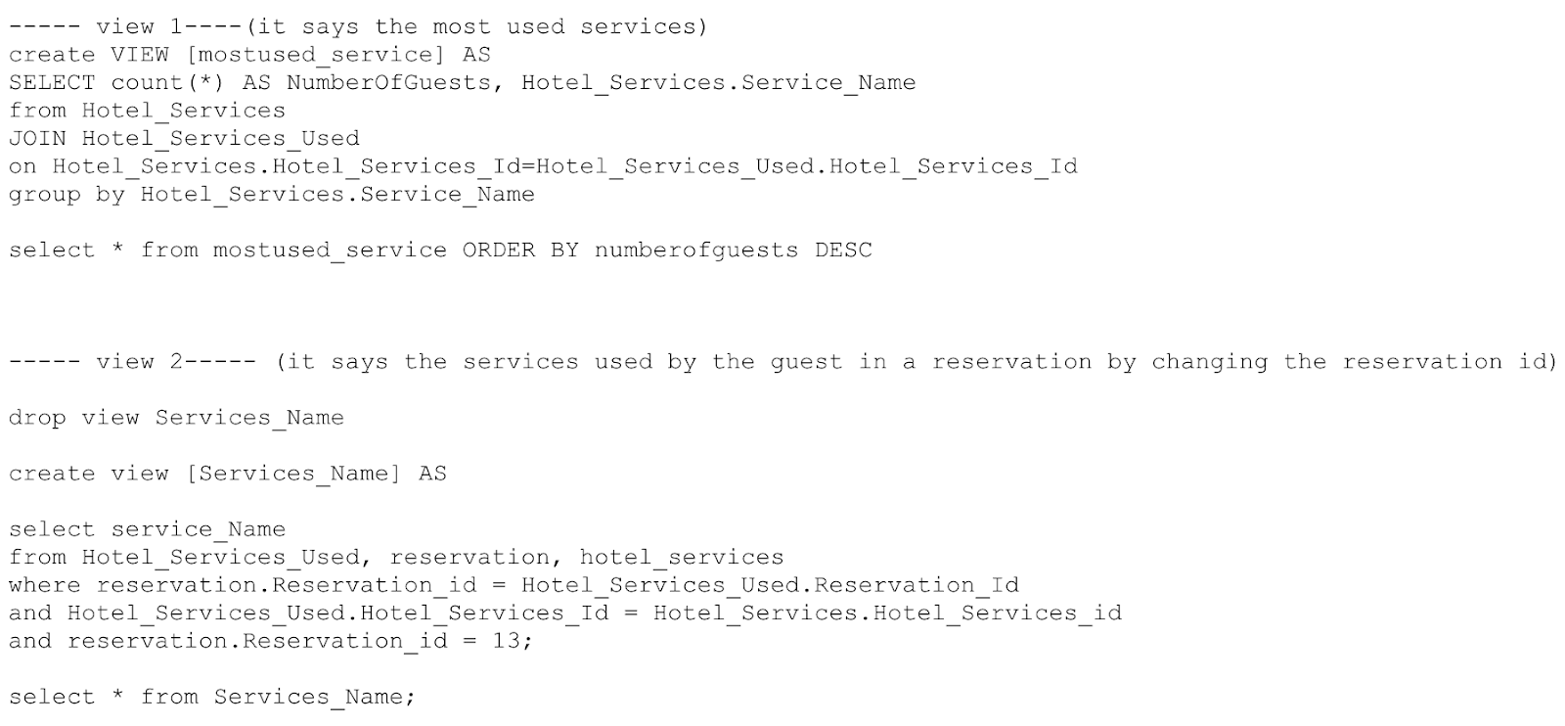
VIEWS
Link
View 1 is created to view the most used services and View 2 is created to view the services used by the customer.

Slide 17
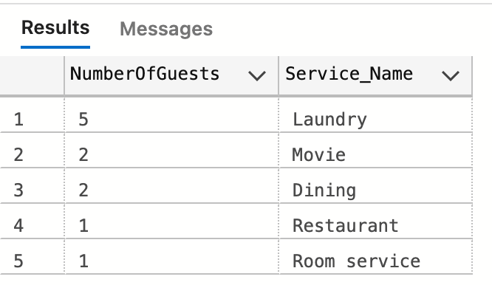
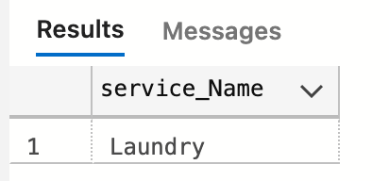
Output of the Views
VIEW -1
VIEW -2

Slide 18
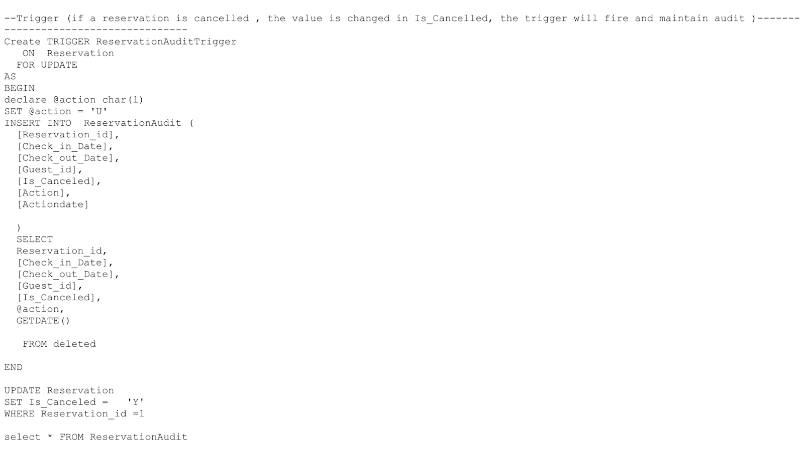
TRIGGERS
Link
This trigger is created to have the details of the reservations made which stores the details of the updated rows and gives date and time of the action performed. The details are stored in the ReservationAudit table.

Slide 19
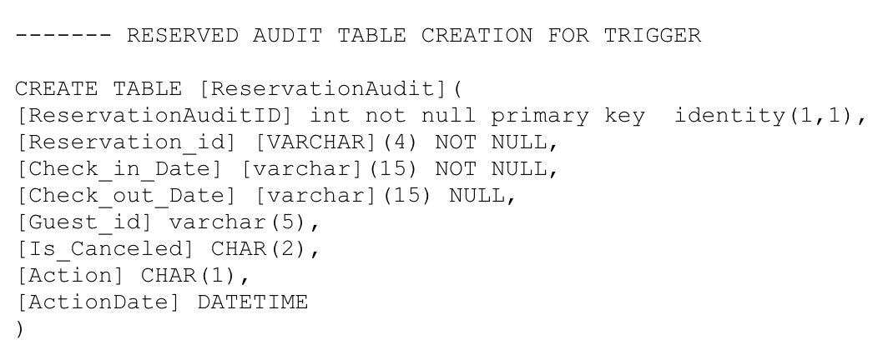
Table created to store the updated values from the trigger

Slide 20
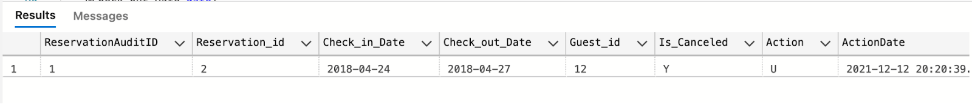
Output of the trigger :
The output of the trigger has the details of cancellation and the action performed and the date and time of the action performed.

Slide 21
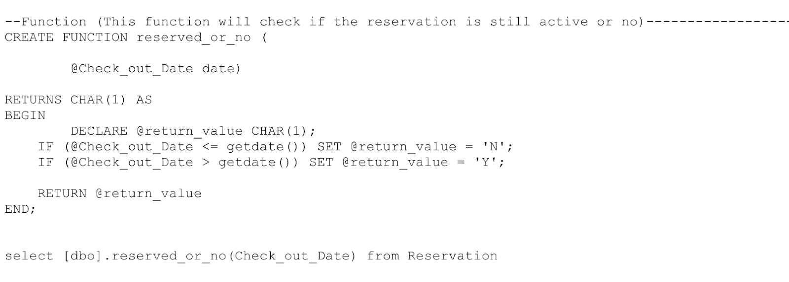
FUNCTION
This Function is created to check if the reservation is still active or no. this will take the checkout date
and compare with today’s date and will return “Y” if it is active and “N” if it is not active.

Slide 22
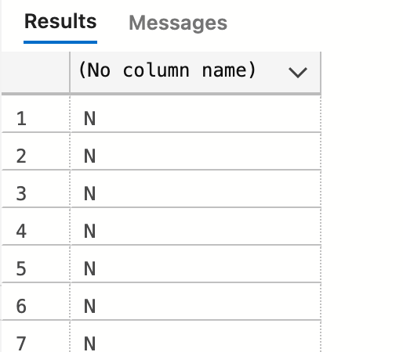
Output of the function:
As the date of the reservations in the database doesn’t have today’s date the reservations are not active.

Slide 23
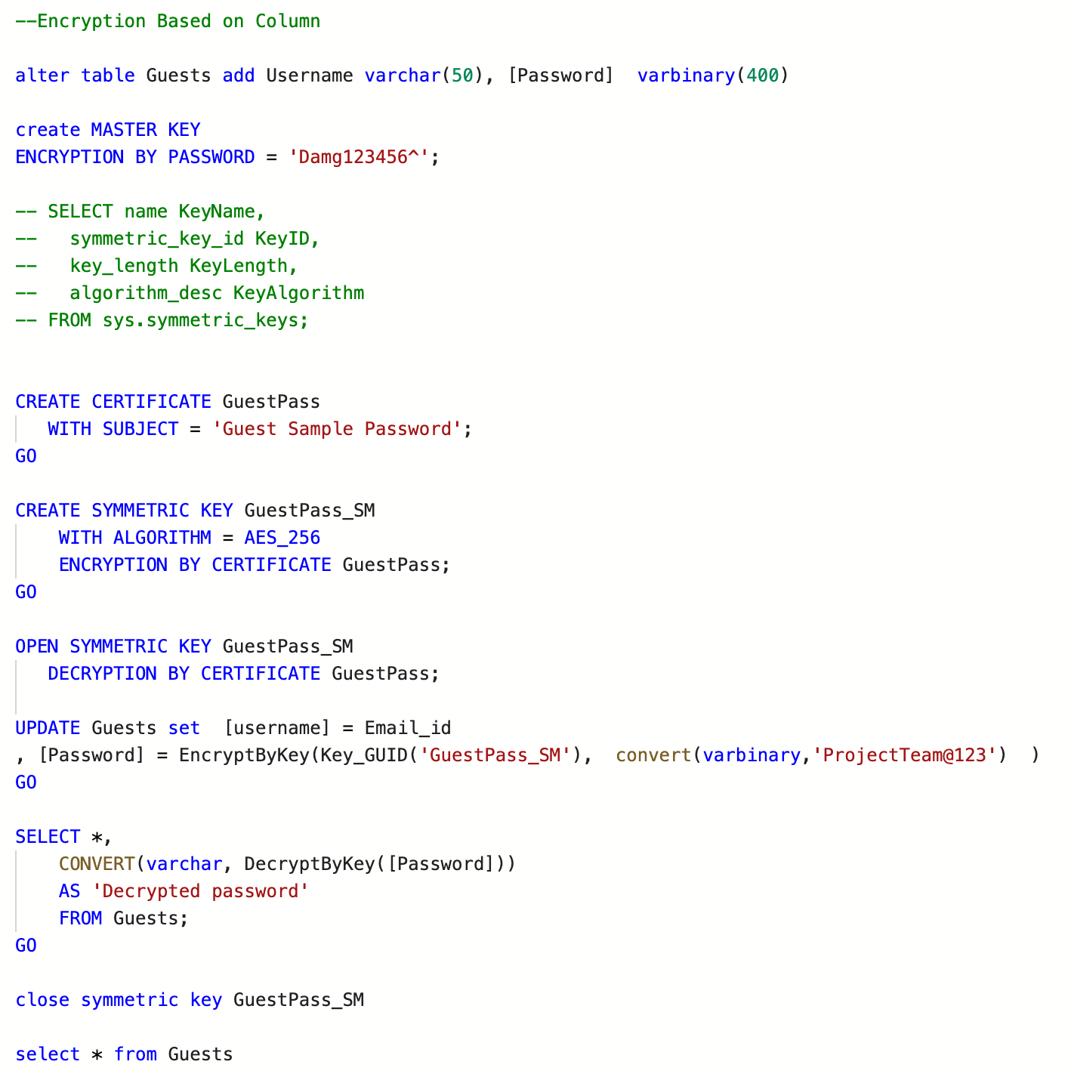
ENCRYPTION
Encryption is done for the password column in the Guest table

Slide 24
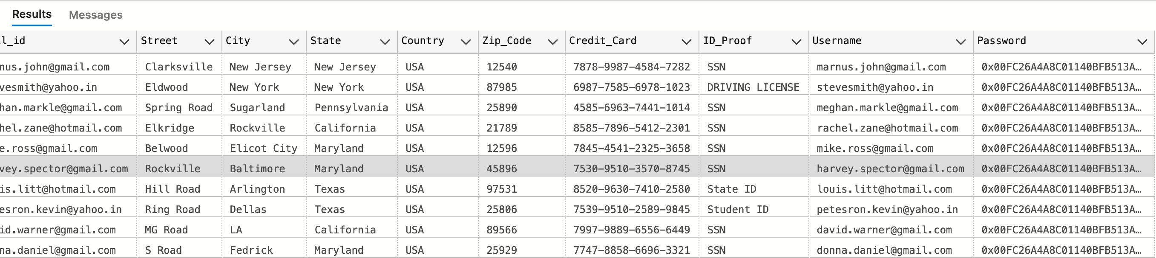
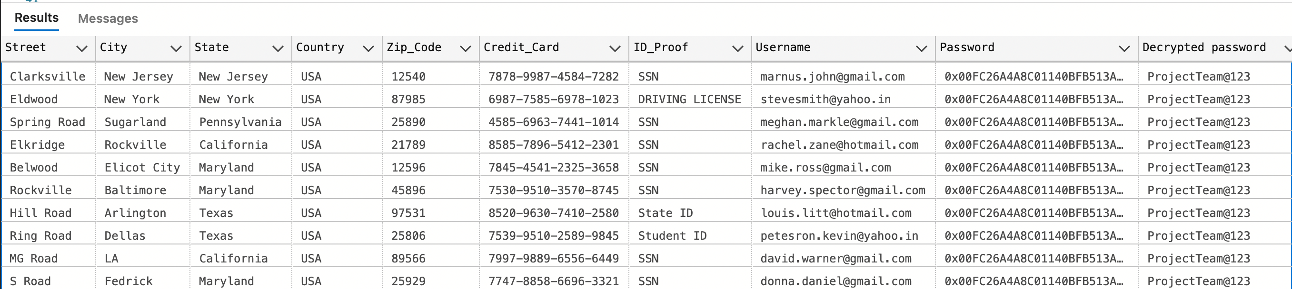
Output of the Encrypted table(In Password) before using the key:
Output of the Encrypted table(In Password) after using the key:

Slide 25
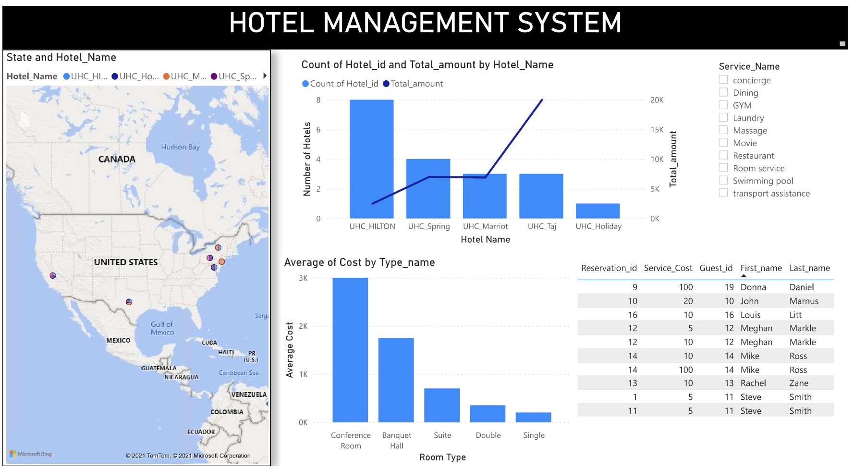
DASHBOARD

Slide 26

This Photo by Unknown Author is licensed under CC BY-NC

